Slide 1
Amazon Product review Data Analysis
Jaydeep J Chopde
Maitri S Shah
Monika Mishra
Pankti N Parikh
Rakshith Chandan Babu
Under the guidance of Dr. Jongwook Woo

Slide 2
Introduction
Customer on any online shopping sites make purchasing decisions based on reviews and ratings.
And so it’s very important for business to know various shopping patterns and customer’s sentiments.

Slide 3

About the dataset
Data is collected from Amazonaws site
Products reviewed on Amazon site between 2005 and 2015 are analyzed
Products reviewed from four countries are considered : US, UK, FR (France), DE (Denmark)
File Size : 5.26 GB
Number of Files : 8
File Format : TSV (Text Separated Values)
Total no. of product reviews : 9.57 million

Slide 4

Cluster details
Cluster Version : Oracle Big Data Cloud Service
No. of Nodes : 2
Memory Size : 16 GB x2
CPU : 4vcpu x2
HDFS Disk : 600 GB x2

Slide 5

Big data
Big data is a term used to refer to the study and applications of data sets that are too complex for traditional data-processing application software to adequately deal with.
It works on the principle that the more you know about anything the more reliably you can gain new insights and make predictions about it’s future. By comparing more data points, relationships begin to emerge and these relationships enable us to learn and make smarter decisions.

Slide 6

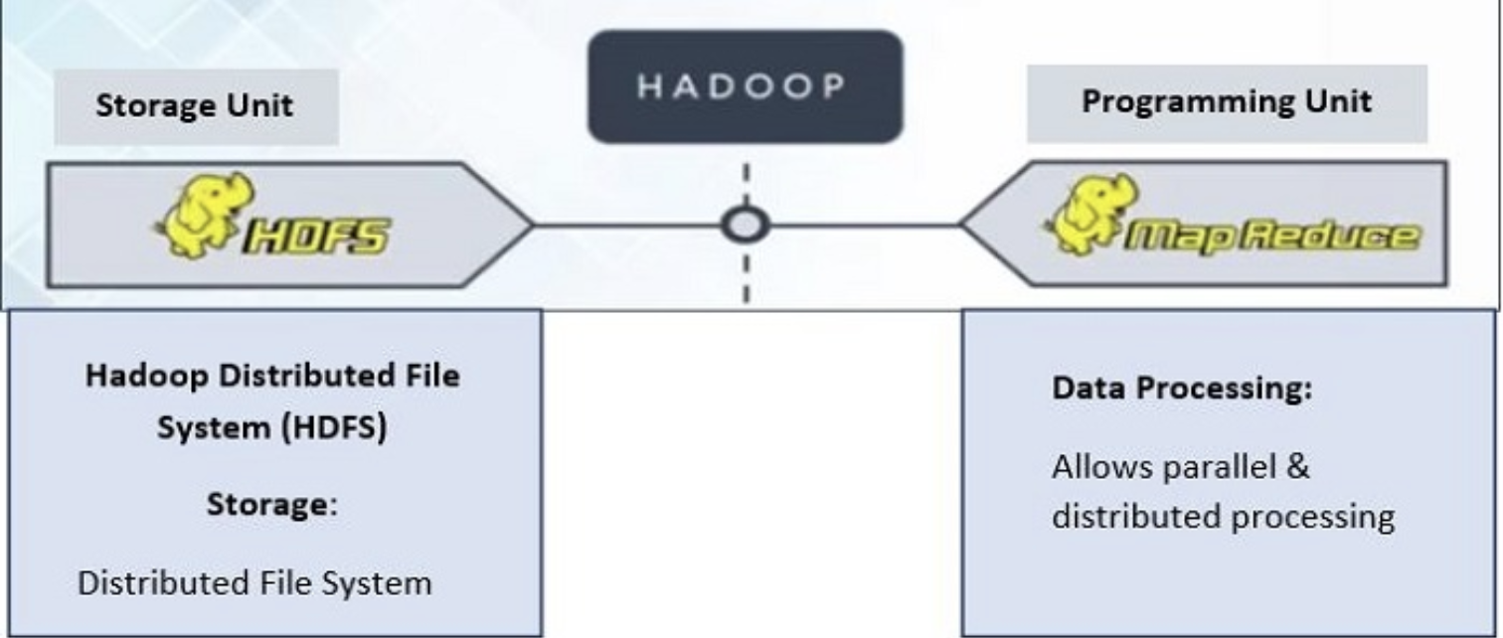
hadoop
Hadoop is a framework to process Big Data. It is a framework that enables you to store and process large data sets in parallel and distributed fashion.
Hadoop Core Components:
Hadoop Distributed File System (HDFS) takes care of storage part of Hadoop architecture.
MapReduce is a processing model and software framework for writing applications which can run on Hadoop. These programs of MapReduce are capable of processing Big Data in parallel on large clusters of computational nodes.

Slide 7

hive
Hive is a data warehouse infrastructure tool to process structured data in Hadoop. It resides on top of Hadoop to summarize Big Data, and makes querying and analyzing easy.
Initially Hive was developed by Facebook, later the Apache Software Foundation took it up and developed it further as an open source under the name Apache Hive.
It stores schema in a database and processed data into HDFS.
It provides SQL type language for querying called HiveQL.
It is familiar, fast, scalable, and extensible.

Slide 8
Data Source URLs
US : https://s3.amazonaws.com/amazon-reviews-pds/tsv/amazon_reviews_multilingual_US_v1_00.tsv.gz
DE : https://s3.amazonaws.com/amazon-reviews-pds/tsv/amazon_reviews_multilingual_DE_v1_00.tsv.gz
UK : https://s3.amazonaws.com/amazon-reviews-pds/tsv/amazon_reviews_multilingual_UK_v1_00.tsv.gz
FR : https://s3.amazonaws.com/amazon-reviews-pds/tsv/amazon_reviews_multilingual_FR_v1_00.tsv.gz
US Dictionary : https://s3.amazonaws.com/hipicdatasets/dictionary.tsv
German Dictionary : http://www.ulliwaltinger.de/sentiment/GermanPolarityClues-2012.zip

Slide 9






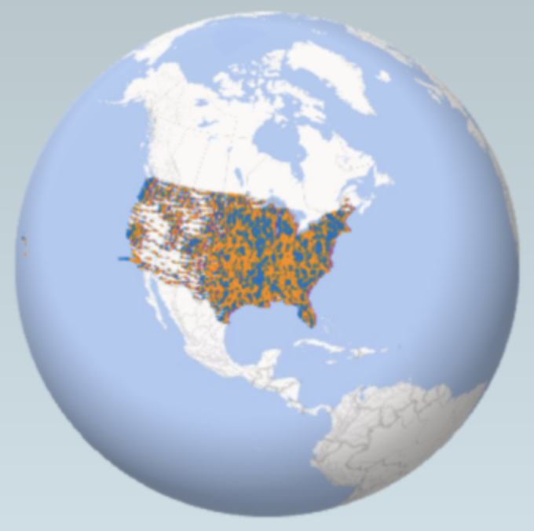

Flowchart
Download Dataset
Upload data into HDFS
Trigger Hive Queries
Output Visualizations
Find Insights

Slide 10
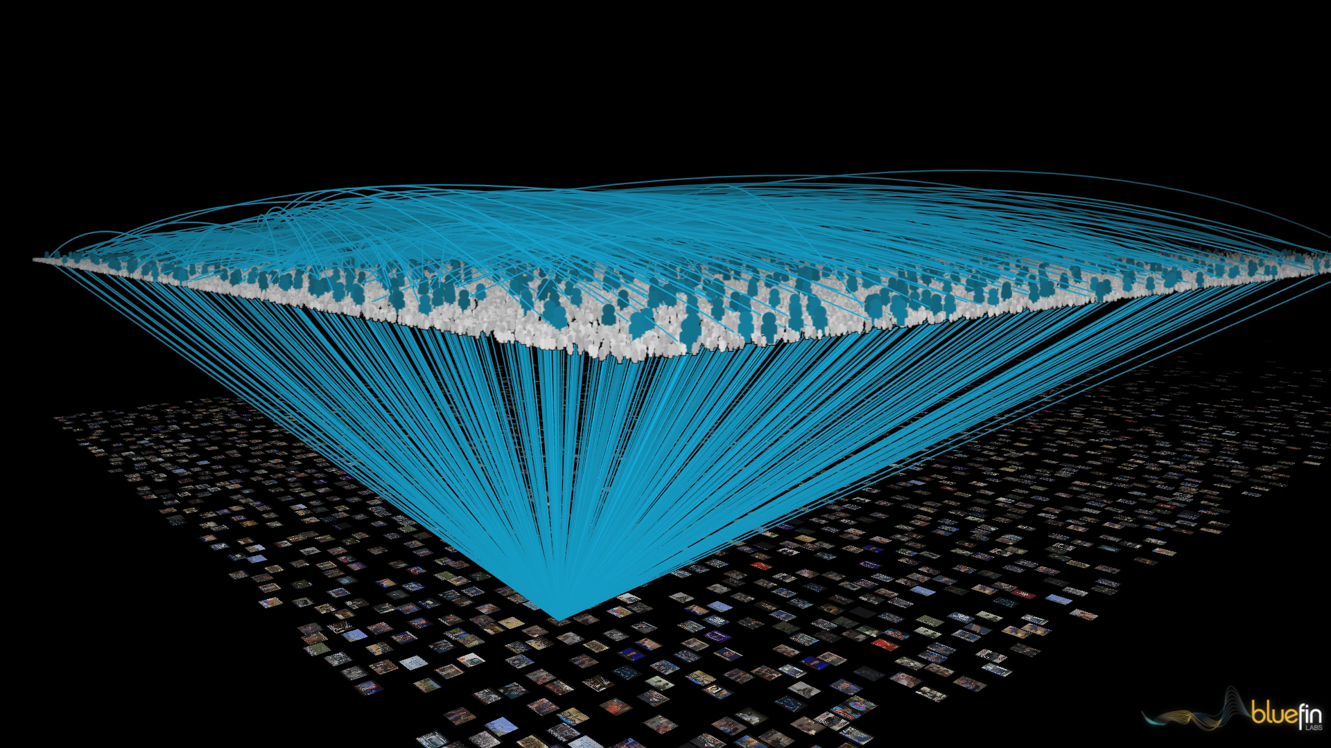


visualizations

Slide 11
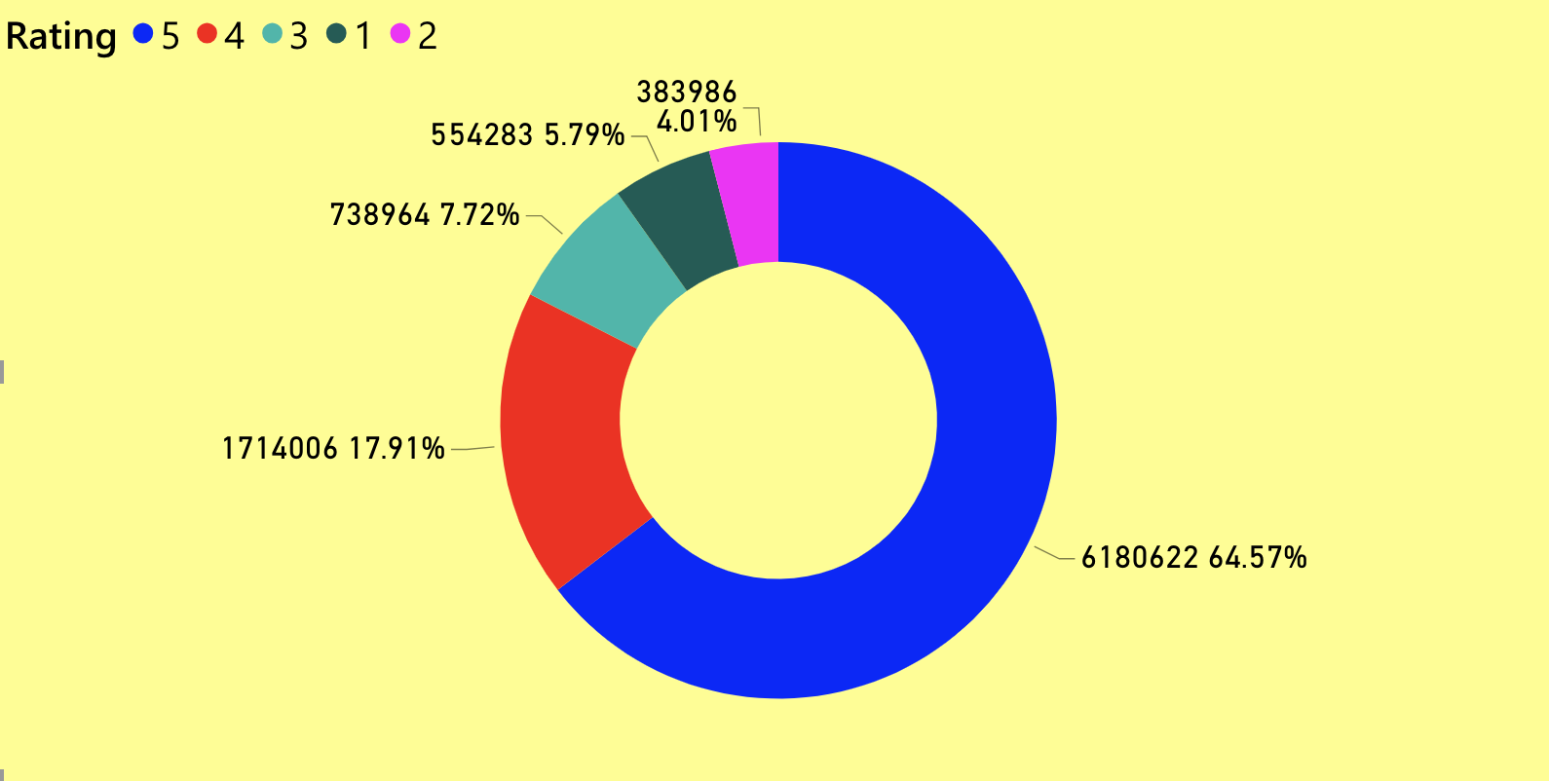
Distribution of overall ratings oF amazon products

Slide 12
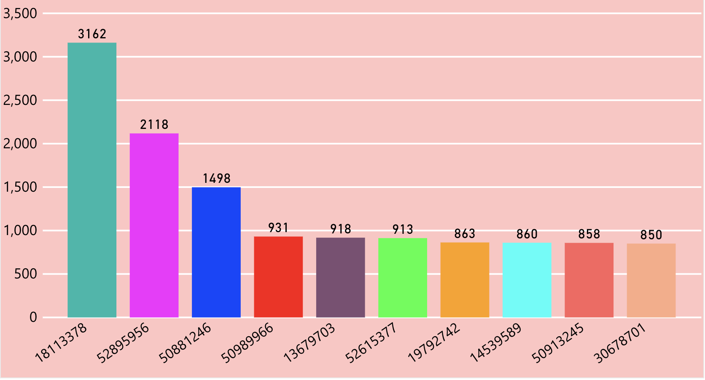
Number of reviewS given by unique users over 10 years

Slide 13
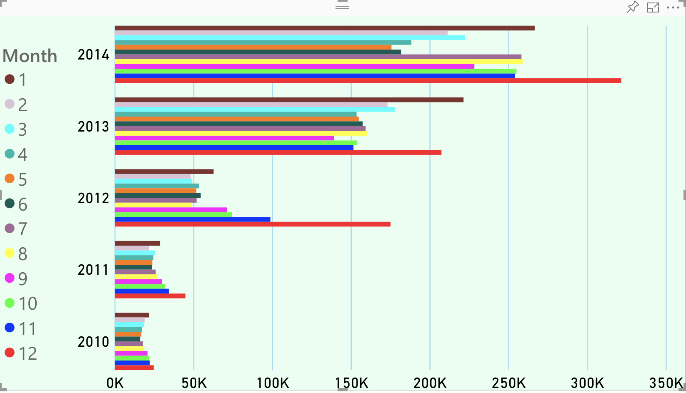
Review count by Year and month

Slide 14
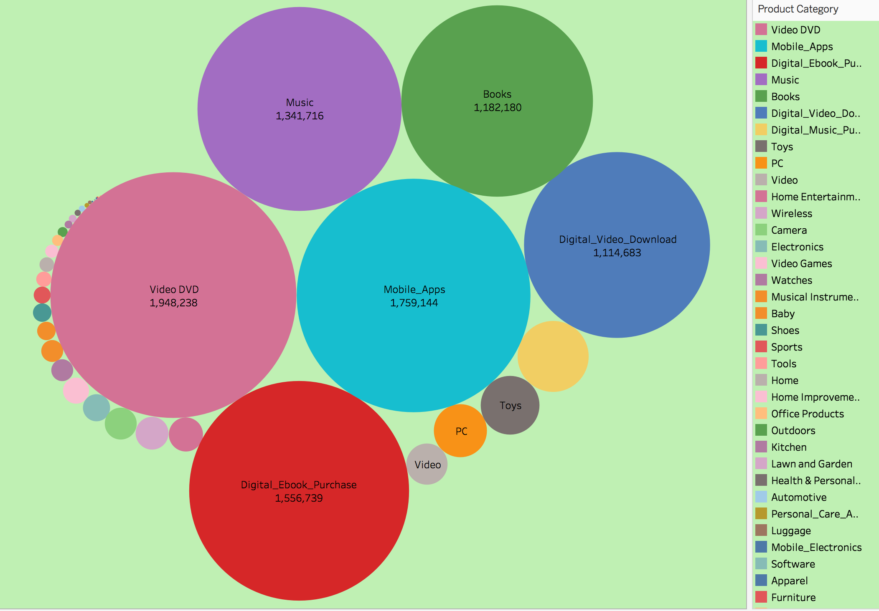
Review count for product CATEGORY

Slide 15
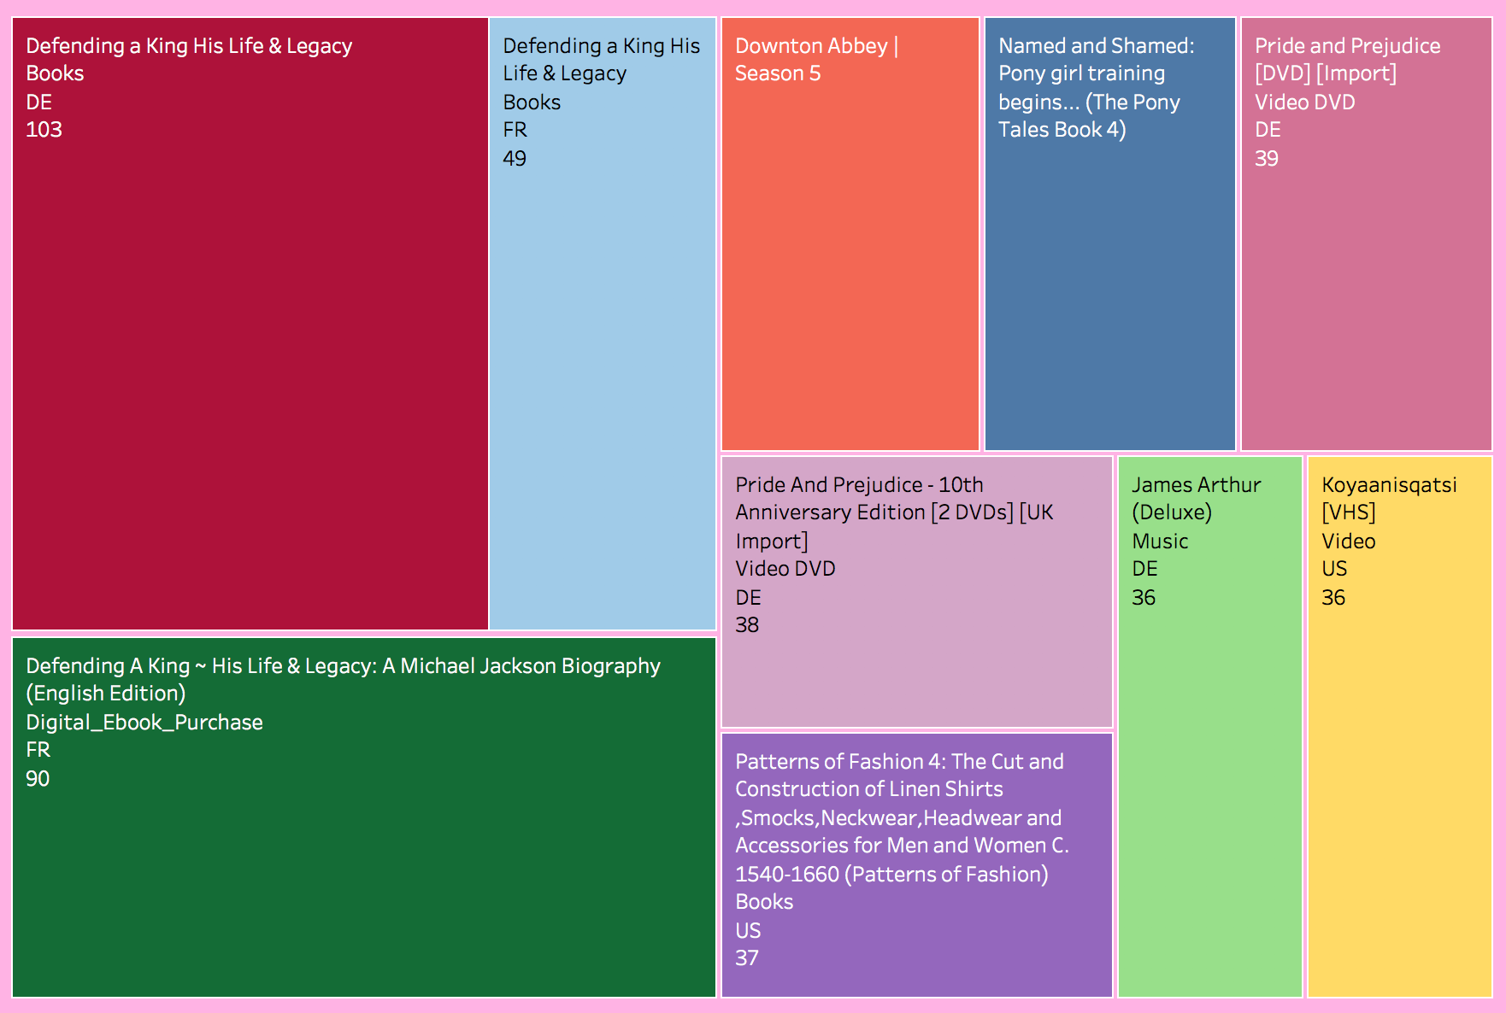
Popular product based on average rating and review Count

Slide 16
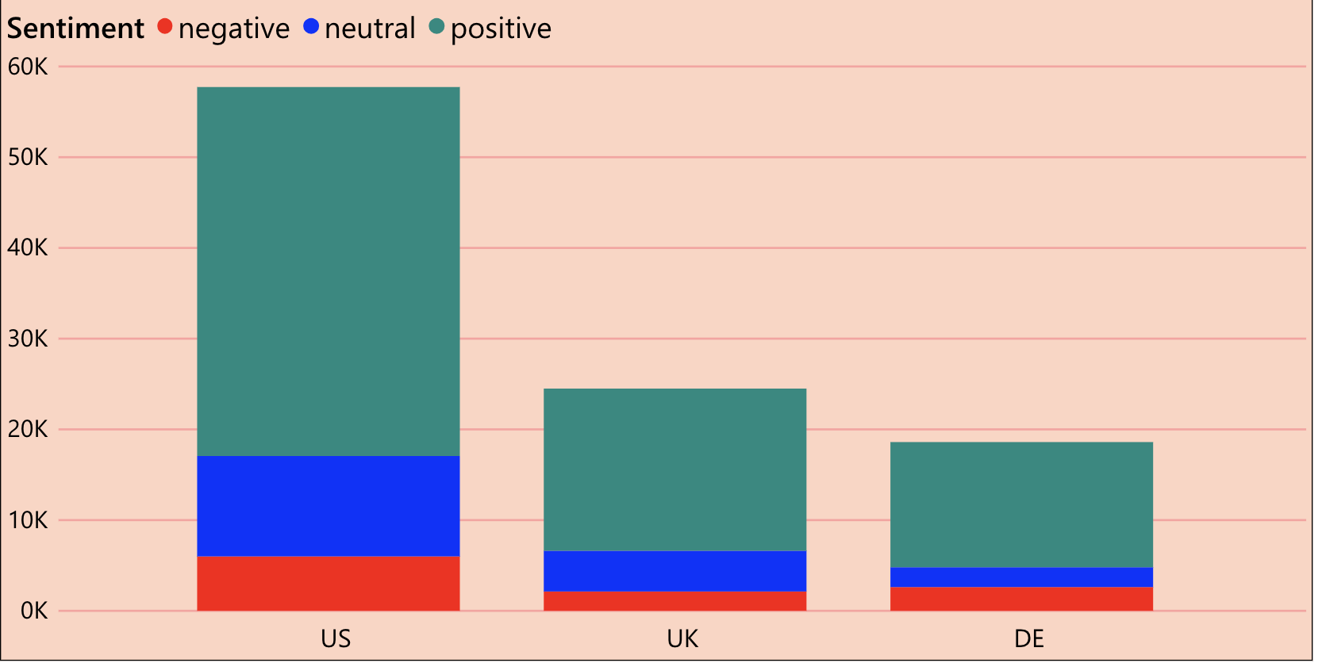
Sentiment analysis oF Toys category by country

Slide 17
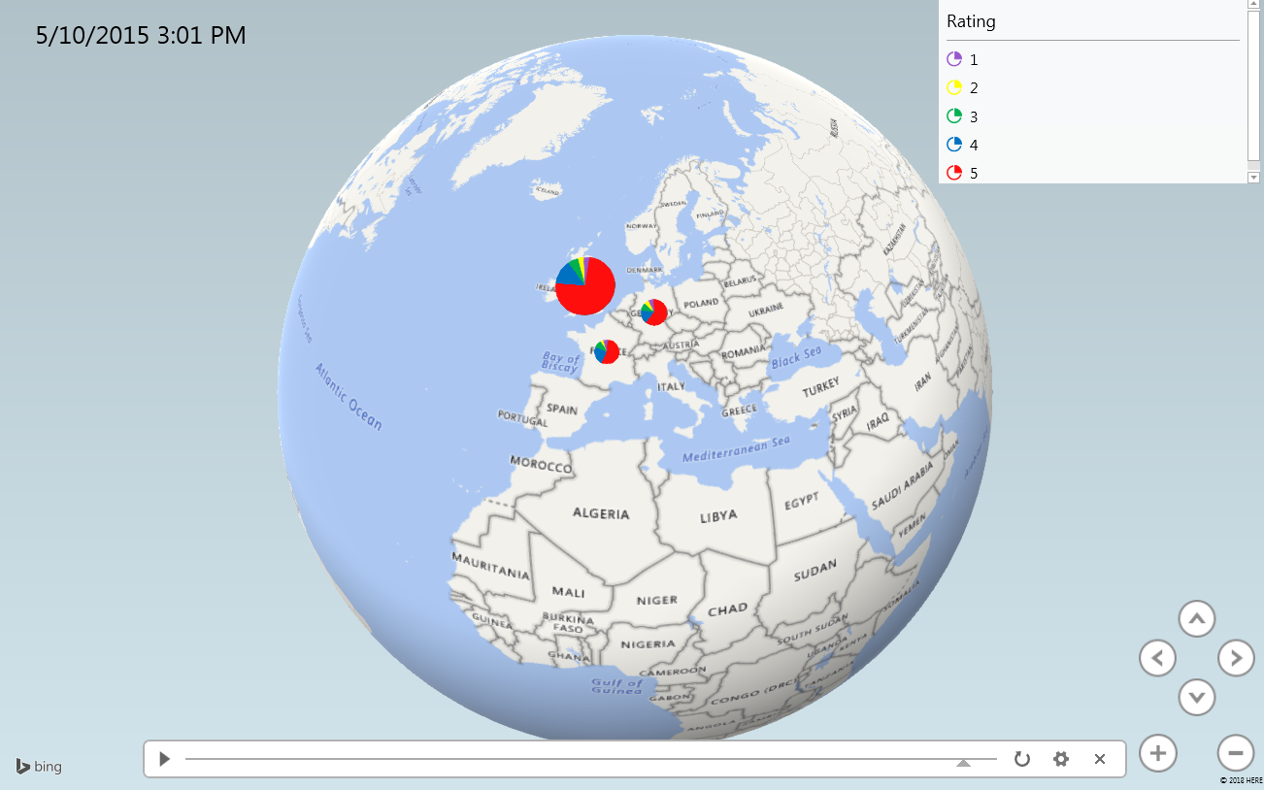
Rating based Geospatial representation for product category-baby

Slide 18

INSIghts
Books is the most popular category based on ratings and reviews
Around 3,162 reviews(maximum) were written by one user in the span of 10 years
The review count has gradually increased over the years
The review count is maximum in the holiday months – November, December, January
64.57% people gave the maximum rating 5 to the products
Video DVD received the maximum number of reviews

Slide 19

GITHUB LINK
https://github.com/monika2403/mmishra2

Slide 20
references
https://aesthetecurator.com
https://en.wikipedia.org/wiki/Big_data
https://www.bernardmarr.com/
https://github.com/
https://s3.amazonaws.com/
http://www.ulliwaltinger.de/sentiment/

Slide 21


